Slide 1
The Experimenting Phase
and Relationship Betterment
By: Carter bell

Slide 2
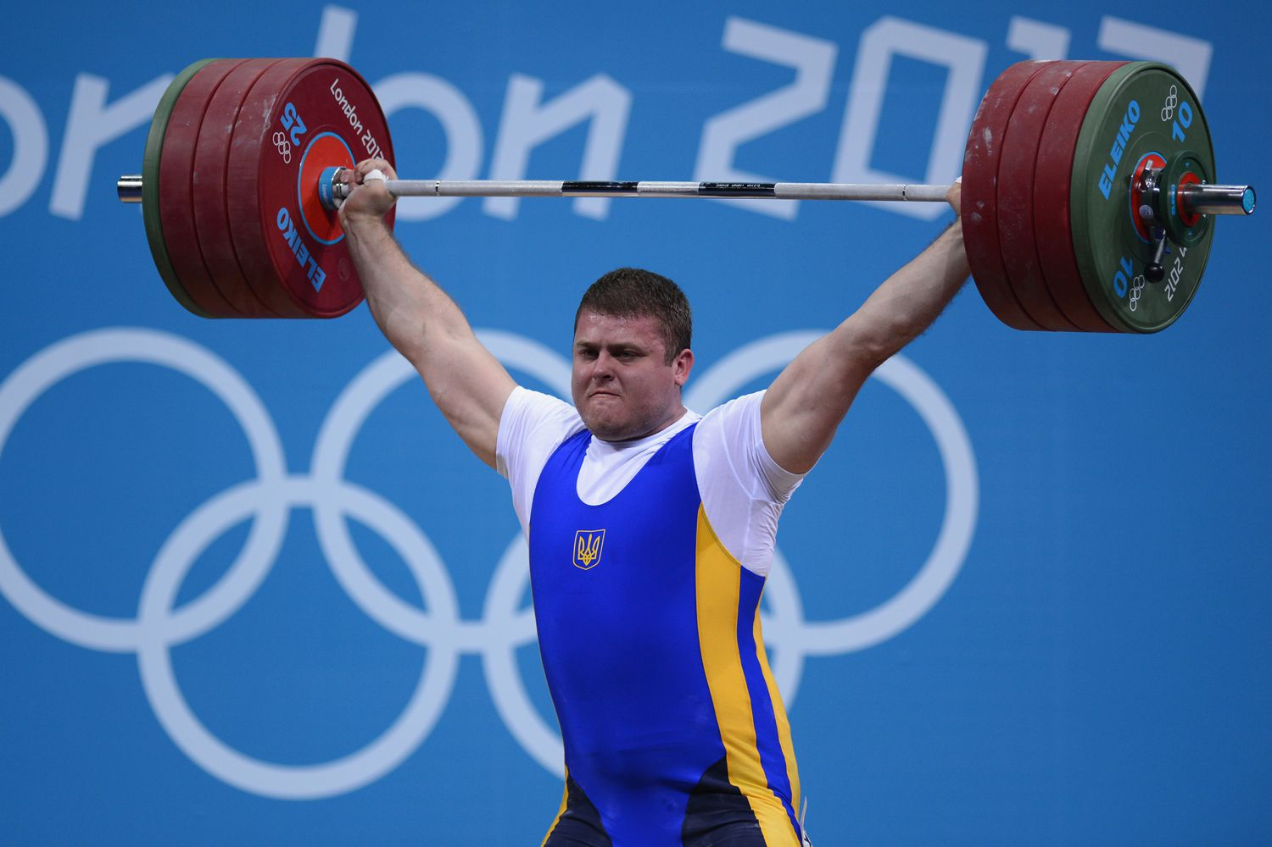
Sine qua non
(Weight lifting. Digital Image. Google Images.)
“Small talk is the sine qua non of experimenting.” -(Knapp & Vangelisti, 2005, p. 155)
Notes:
Attention Getter: “Small talk is the sine qua non of experimenting.” By this, some of you may be left wondering, what did he just say? To answer your question, in their 2005 book Interpersonal Communication and Human Relationships, Knapp and Vangelisti described the experimenting stage with those exact words. To clarify, sine qua non, means something that is absolutely necessary. They then support this claim by saying small talk is like exercising: many people may hate it, however, we engage in large quantities of it each day.
Credibility: My research on the topic of the experimenting stage began with an interest in forming better relationships and maintaining those higher-quality relationships. To define the experimenting stage: it is when strangers exchange information and often become acquaintances afterward. My first source for this stage is the textbook that we use for our class: Communication in the real world. As for my second source, I used Google Scholar to find a scanned version of another communication textbook: Interpersonal Communication and Human Relationships which I previously referenced.
Therefore, using these sources, I’ll help you better understand the Experimenting phase, which is an essential part of being able to develop and maintain meaningful relationships.
Transition: I’ll begin with the importance of small talk.

Slide 3

The Key - Small Talk
(Small talk. Digital Image. Google Images.)
Has two main uses...
Notes:
Main Point: As previously stated, small talk is absolutely-necessary in the experimenting stage. It is the key to more meaningful relationships and it has two main uses. The first one being the “sniffing ritual”.

Slide 4
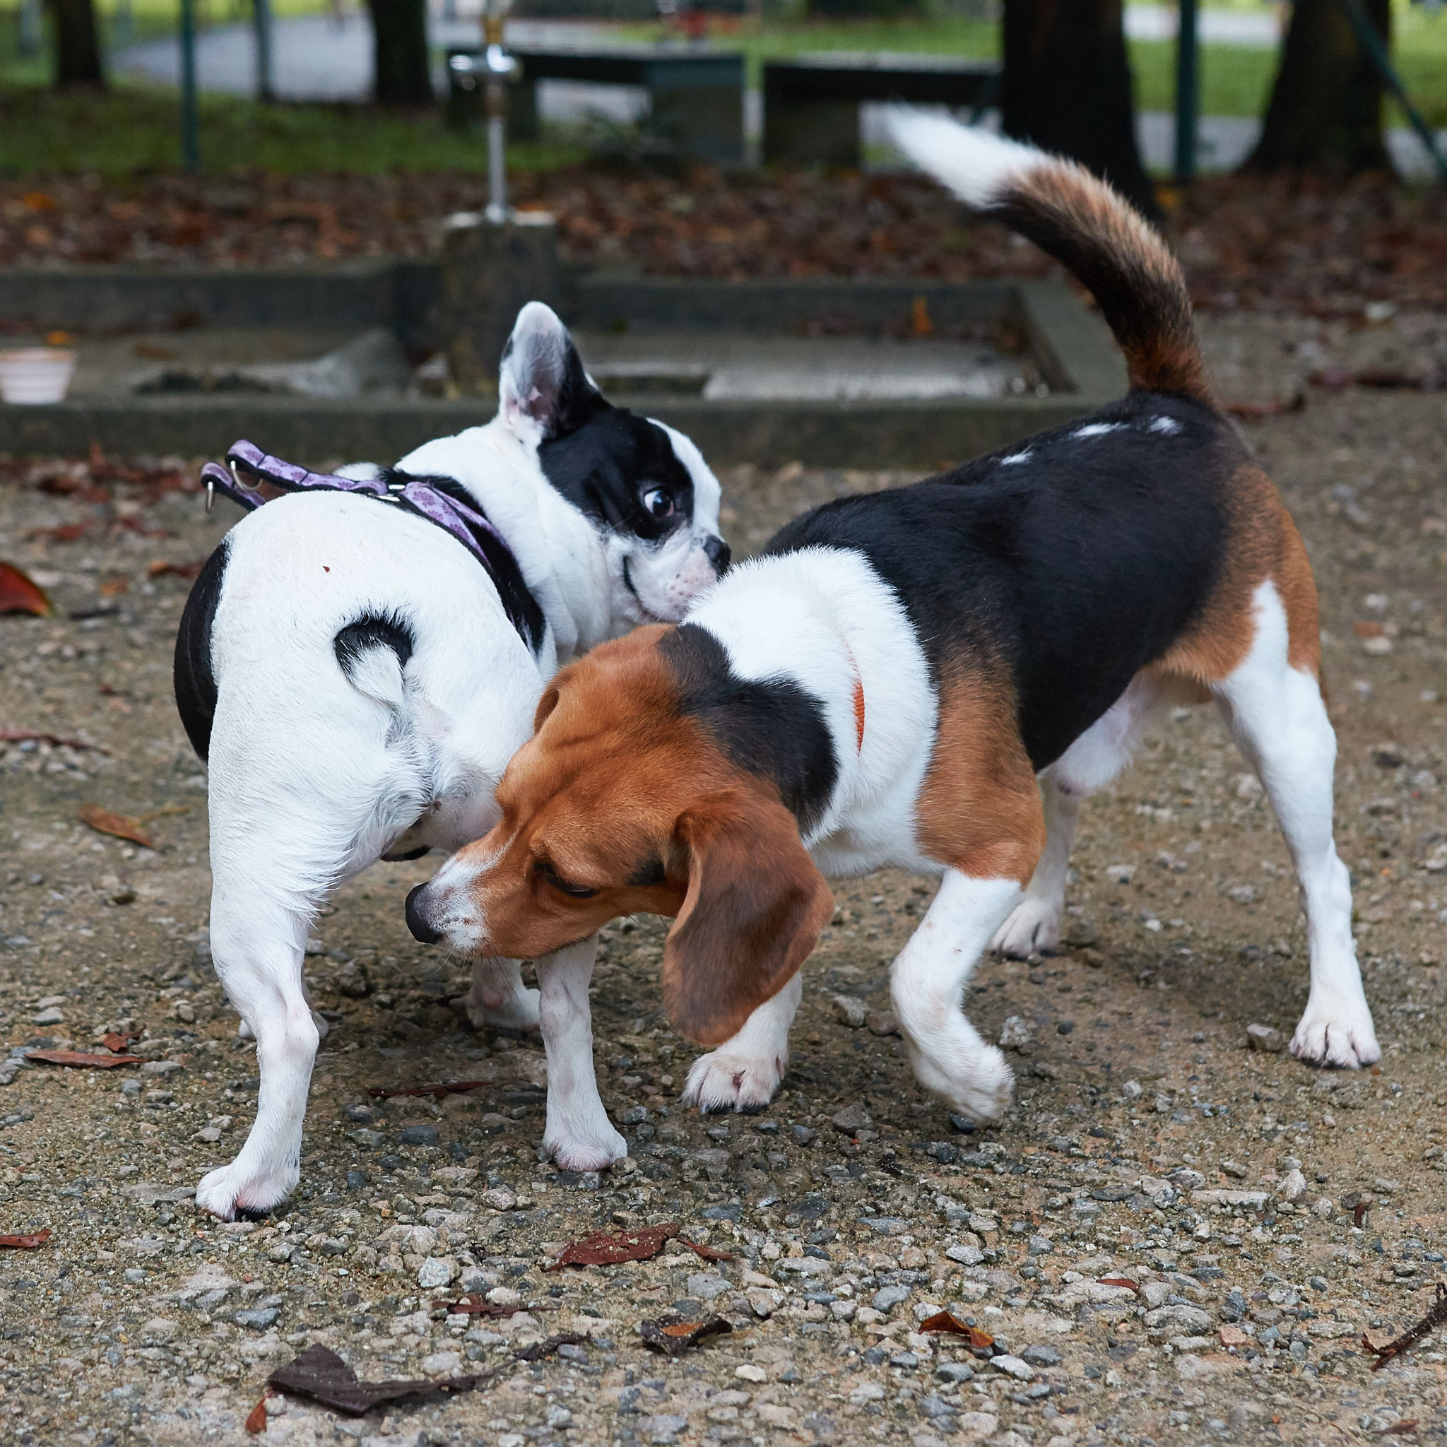
First Use of Small Talk
(Sniffing ritual. Digital Image. Google Images.)
“Sniffing Ritual”
Basic Information Exchange
Influenced by setting
Main turning point
Requires Diligence
Notes:
Supporting Point: According to the 2019 book Communication in the real world from Libretexts, scholars have likened the experimenting stage to the “sniffing ritual” of animals.
Sub-Supporting Point: This can be seen through basic information exchange which is usually influenced by the setting of your conversation: Whether you’re meeting the person you sit next to in class or meeting a stranger at a sports game.
Sub-Supporting Point: You’ll most likely repeat this process multiple times, asking questions to discover more about what that person is like. All the while, deciding whether or not to continue the conversation based on how well your interests or personalities align.
Supporting Point: This small talk-oriented sniffing ritual is the main turning point in developing a better relationship with somebody.
Sub-Supporting Point: As stated by Knapp and Vangelisti in their 2005 book Interpersonal communication and human relationships, “Strangers at this stage are diligently searching for an integrating topic, an area of common interest or experience.”
Sub-Supporting Point: The keyword here is diligently. You have to be diligently engaged in discovering an integrating topic with that person, it doesn’t just happen on its own. That is how you will begin forming a much more meaningful relationship with that person if you truly intend to do so.
Transition: As you can see small talk is important, however, what about the second main use of small talk?

Slide 5

Second Use of Small Talk
(Relationship. Digital Image. Google Images.)
Experimenting stage
Main stage of most Relationships
Thus: Relationship Maintenance
Catching up/Checking up
Recounting the day
Notes:
Main Point: Well since most relationships don’t progress past the experimenting stage, the second main use of small talk is relationship maintenance.
Supporting Point: LibreTexts’ 2019 version of Communication in the real world states, “Experimenting continues in established relationships.” It describes small talk as common when catching up with parents during a visit home, or among married couples when recounting their day over dinner.
Supporting Point: Small talk doesn’t only uncover the pathway to forming a relationship with a stranger. It also acts as a means of maintaining and checking up on those relationships in order to keep them healthy.
Transition: Now, to quickly recap before concluding.

Slide 6
Conclusion - Use the tools!
Diligence with “Sniffing Ritual” (small talk)
Find integrating topic
More meaningful relationship
Maintain relationship with small talk
Check in
Show that you care
Notes:
Review: Small talk is at the heart of the “sniffing ritual”. In order to form a more meaningful relationship with a stranger, you need to be diligently engaged in finding that integrating topic, that common interest that will act as a guide for the rest of your relationship.
Closing Statement: Establishing and maintaining more meaningful relationships will take some effort. The experimenting stage can be long and even confusing at first. However, if you rely on small talk to uncover the identity of a stranger and find a common interest, great! Run with it and work diligently to develop a meaningful relationship. When maintaining a relationship, use small talk. Check-in with that person and show them that you still care about them and the relationship you share. (SLOW TO A CLOSE) Put these tools to use, and pay attention to the results. You’ll notice differences in the sincerity of your relationships. Those are the secrets of the experimenting stage of coming together, and if you let them, they will change your life.

Slide 7
References:
Communication in the real world: An introduction to communication studies. (2019). LibreTexts. https://socialsci.libretexts.org/Bookshelves/Communication/Book%3A_Communication_in_the_Real_World
Knapp, M. L., & Vangelisti, A. L. (2005). Relationship stages: A communication perspective. Interpersonal communication and human relationships, (5th ed., pp. 36-49). Allyn & Bacon, Boston, MA. http://seagull.comcastbiz.net/JR/Assignments/Research_files/Relationship%20Stages-%20%20A%20Communication%20Perspective_1.pdf

